Slide 1
Introduction to Quantum Chemistry
Quantinuum Winter School
Nathan Fitzpatrick
Date

Slide 2
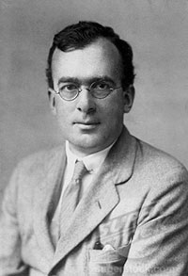

Douglas Hartree
Learnt about differential equations during the first world war
Applied these ideas to Schrodinger equation
First solutions with electron mean field potential in

Slide 3
Atomic Units
Constant nuclear repulsions removed
Hartree unit of energy

Slide 4
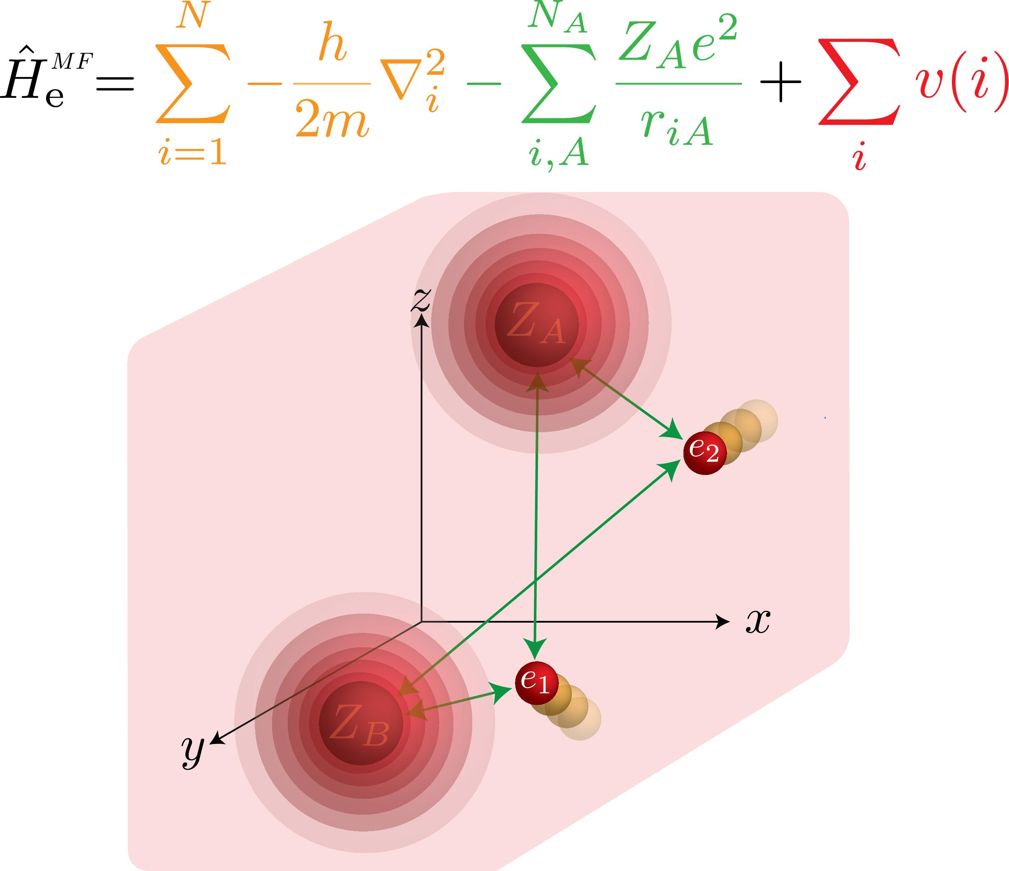
Mean FiEld Approximation

Slide 5
Mean Field Hamiltonian
Mean field potential – average over all other electron not i
Where the electron density is defined as:

Slide 6
Mean Field Approximation

Slide 7
Hartree Product
Mean Field Hamiltonian separable
Calculate WF for each single electron
Many particle WF constructed as a product of exact single particle wavefunction
Approximate mean field approximation
Not Antisymmetric, electrons distinguishable, very wrong

Slide 8
Separable differential equations
Separable non interacting operator (Single particle)
Each particle can therefor be treated with it own equation independently
Still in analytic differential equations picture
Non linear in the spin orbitals
Must be iterated over until the mean field converges (self consistency feedback loop)

Slide 9
Separable differential equations
Separable non interacting operator (Single particle)
How is this different to LCAO?
Some Integro-differential equation can only be solved exactly
Chi can be solved exact for some spherical potentials
Need to apply a basis for molecules like with LCAO

Slide 10
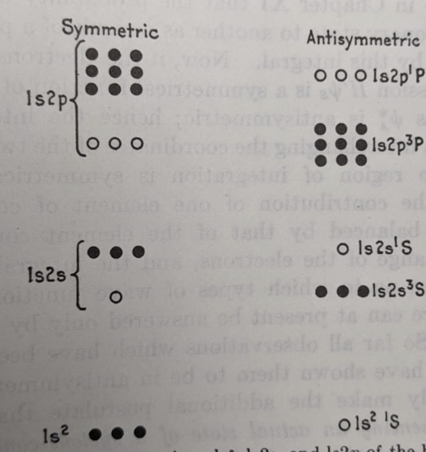
NoN-Physical Solutions
When applied to Helium this method general more solutions than observed by experiment
Only the antisymmetric solutions are in nature.
Need a method to take account for this!

Slide 11
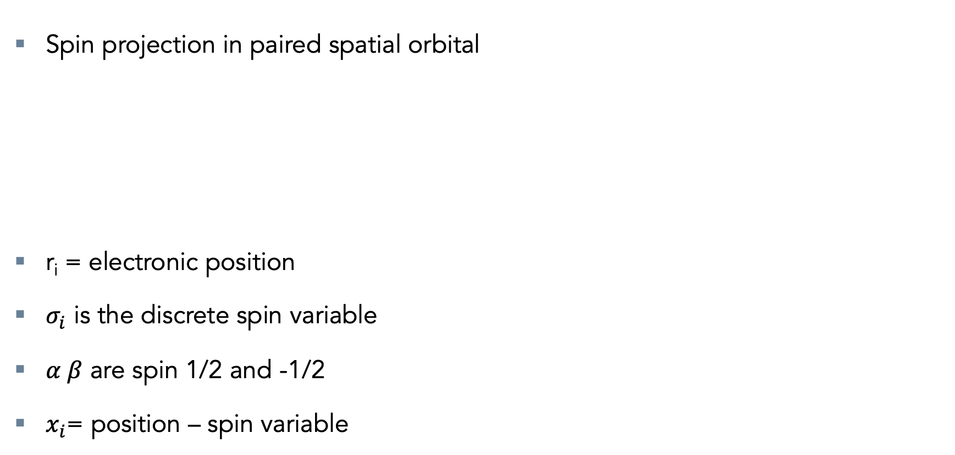
Spin Orbitals
Spin projection in paired spatial orbital
r_{i} = electronic position
$σ_{i}$ is the discrete spin variable
$α β$ are spin 1/2 and -1/2
$x_{i}$= position – spin variable

Slide 12
Antisymmetry
Electrons were discovered to antisymmetric wrt to particle exchange
Because of the universe
How does this effect the Hartree product?

Slide 13
Antisymmetry
2 electron example
How does this effect the Hartree product?
2 electron example

Slide 14
Slater Determinants
Has determinant form
Antisymmetric ket
N electrons

Slide 15
Slater Determinants
Determinant properties
Column switching switches sign
Bra-ket notation

Slide 16
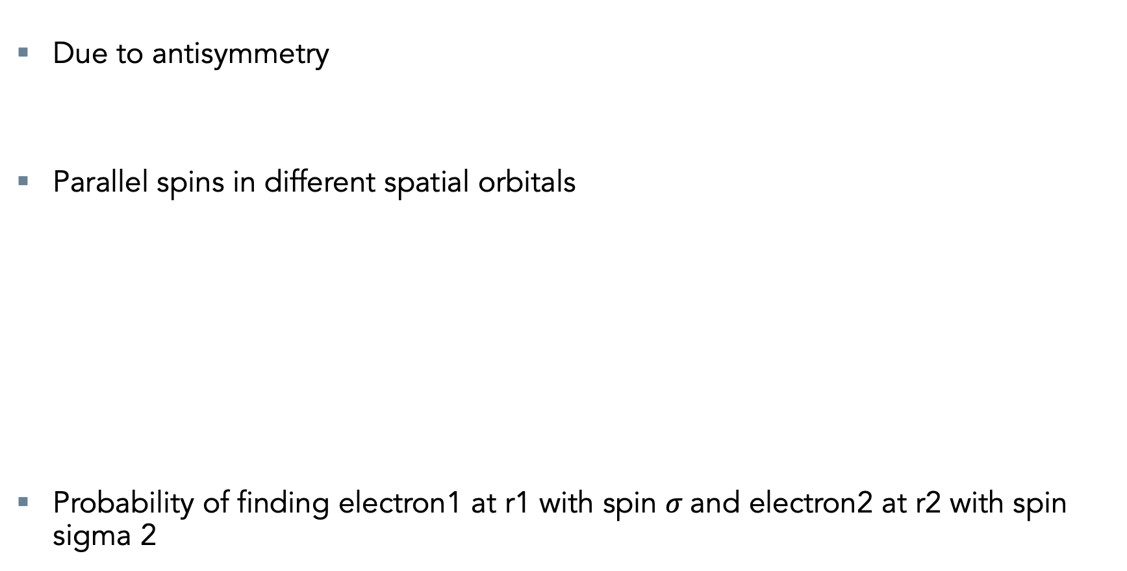
The Exchange Correlation Problem
Due to antisymmetry
Parallel spins in different spatial orbitals
Probability of finding electron1 at r1 with spin $σ$and electron2 at r2 with spin sigma 2

Slide 17
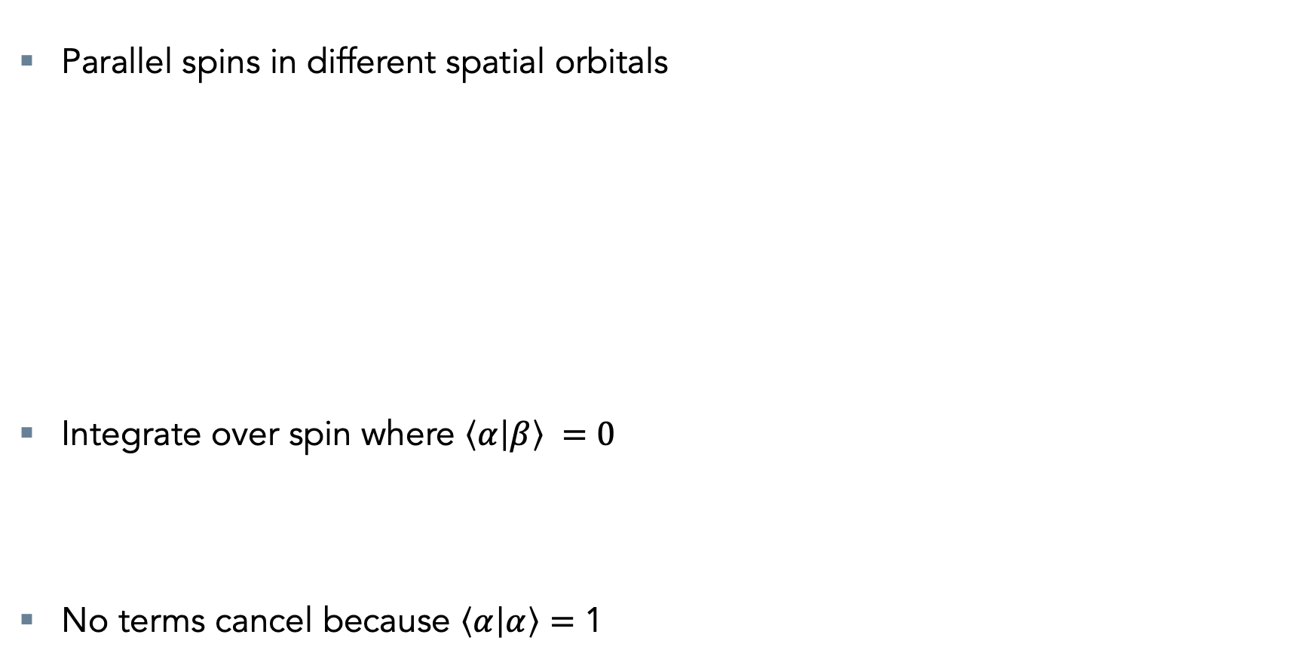
The Exchange Correlation Problem
Parallel spins in different spatial orbitals
Integrate over spin where $\left\langle α | β\right\rangle =0$
No terms cancel because $\left\langle α | α\right\rangle =$ 1

Slide 18
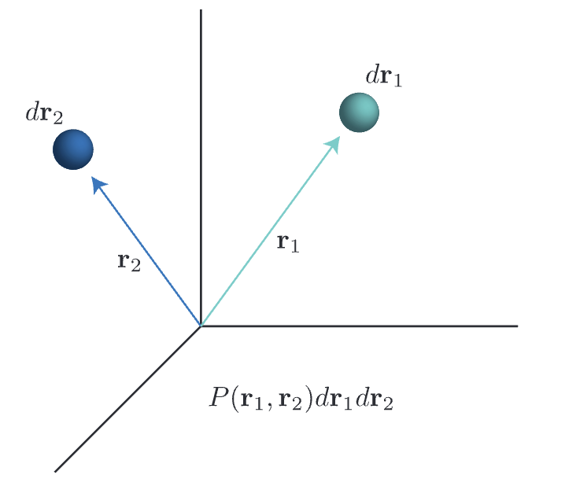
The Exchange Correlation Problem
For parallel spins:
At r1 = r2 in
Parallel spins correlated
Known as exchange correlation
Property of antisymmetric product wavefunction

Slide 19
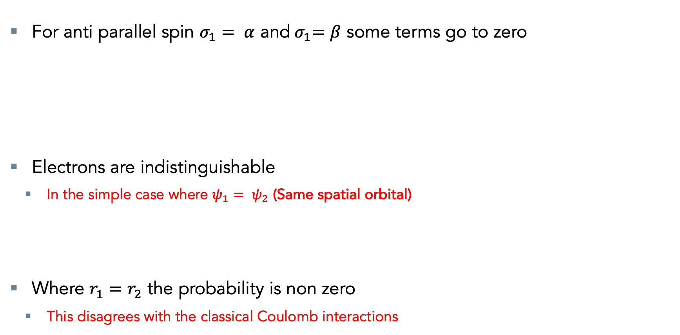
The Exchange Correlation Problem
For anti parallel spin $σ_{1}= α$ and${ σ}_{1}=β$ some terms go to zero
Electrons are indistinguishable
In the simple case where $ψ_{1}= ψ_{2}$ (Same spatial orbital)
Where $r_{1}=$ $r_{2}$ the probability is non zero
This disagrees with the classical Coulomb interactions

Slide 20
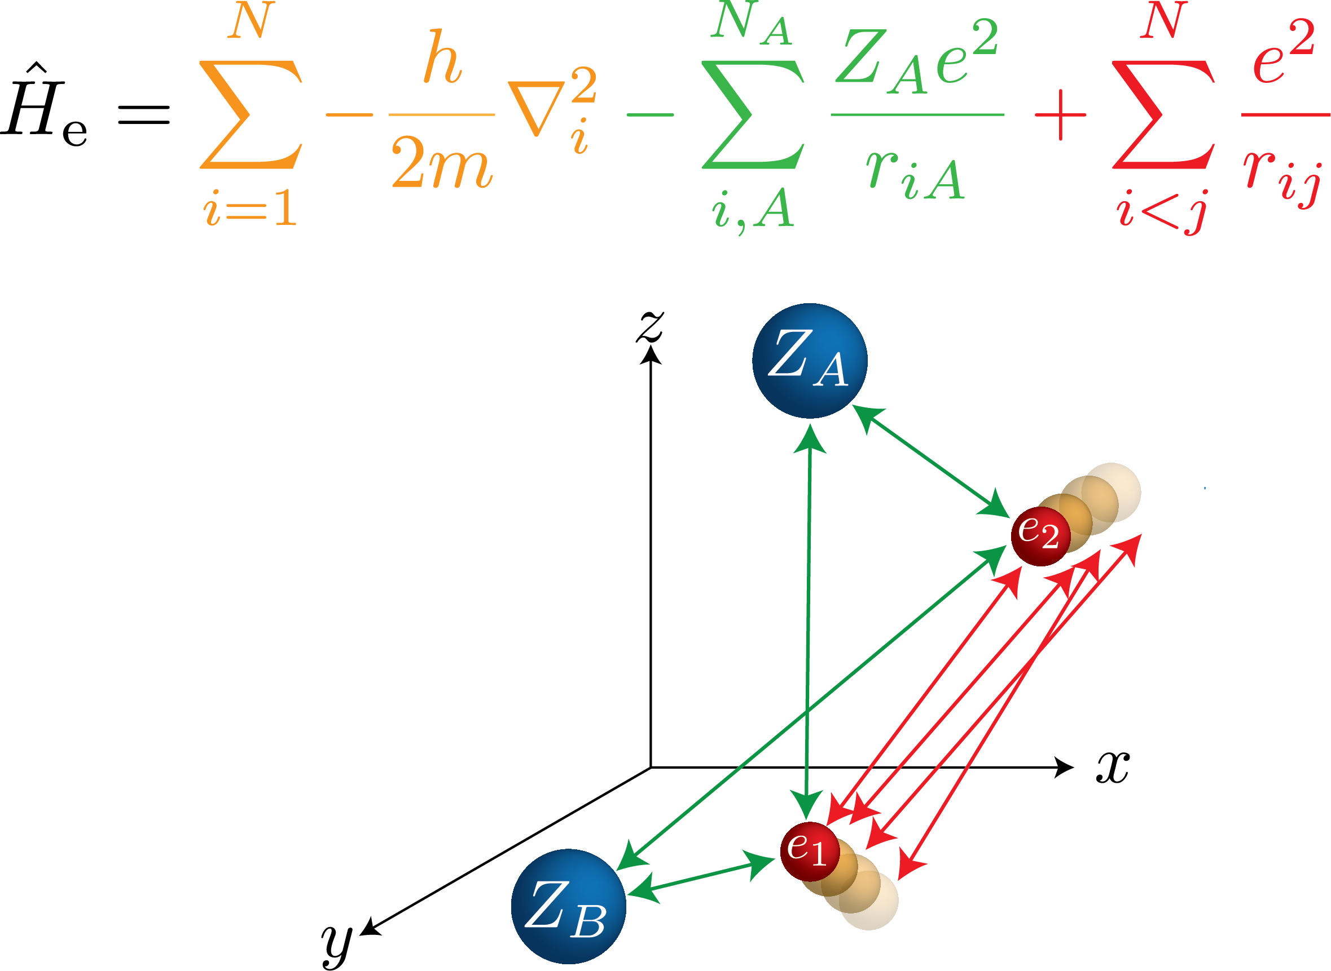
Electronic HAMILTONIAN
Electron kinetic energy
Electron - nuclear attraction
Electron - electron repulsion

Slide 21
E-E repulsion with antisymmetry
Slater Determinant separability
Because:
The two electron terms deal with antisymmetric terms
Bra-ket integral shorthand

Slide 22
E-E repulsion with antisymmetry
Two body term
Because:
Coulomb
Exchange

Slide 23
E-E repulsion with antisymmetry
Two body term
Exact
Coulomb term has a classical analogue of averaged instantons point charge repulsions
Exchange term only exists due to the antisymmetry and is non classical
Coulomb
Exchange

Slide 24
E-E repulsion with antisymmetry
Two body term for opposite spins in a spatial orbital
Holds for opposite spins in any spatial orbitals
Therefor:

Slide 25
E-E repulsion with antisymmetry
Two body term for opposite spins in a spatial orbital
Due to spin orthogonality:
Spin cancelation

Slide 26
E-E repulsion with antisymmetry
This becomes quite obvious when we used the Restricted WF
Where we explicitly show the spatial orbital and spin product
Spatial orbital has the same wavefunction for spin up and spin down
The exchange term only fires when integral has parrel spins
Only happens when we use a Slater determinant WF

Slide 27
Mean field Approximation
One electron mean field Coulomb operator for density averaging
Exact treatment of non-separable treatment

Slide 28
Mean Field Approximation with Antisymmetry
Two body term for opposite spins in a spatial orbital
Density and exchange averaging over r2 as mean field operator
‘Integrate out’ r2 variable

Slide 29
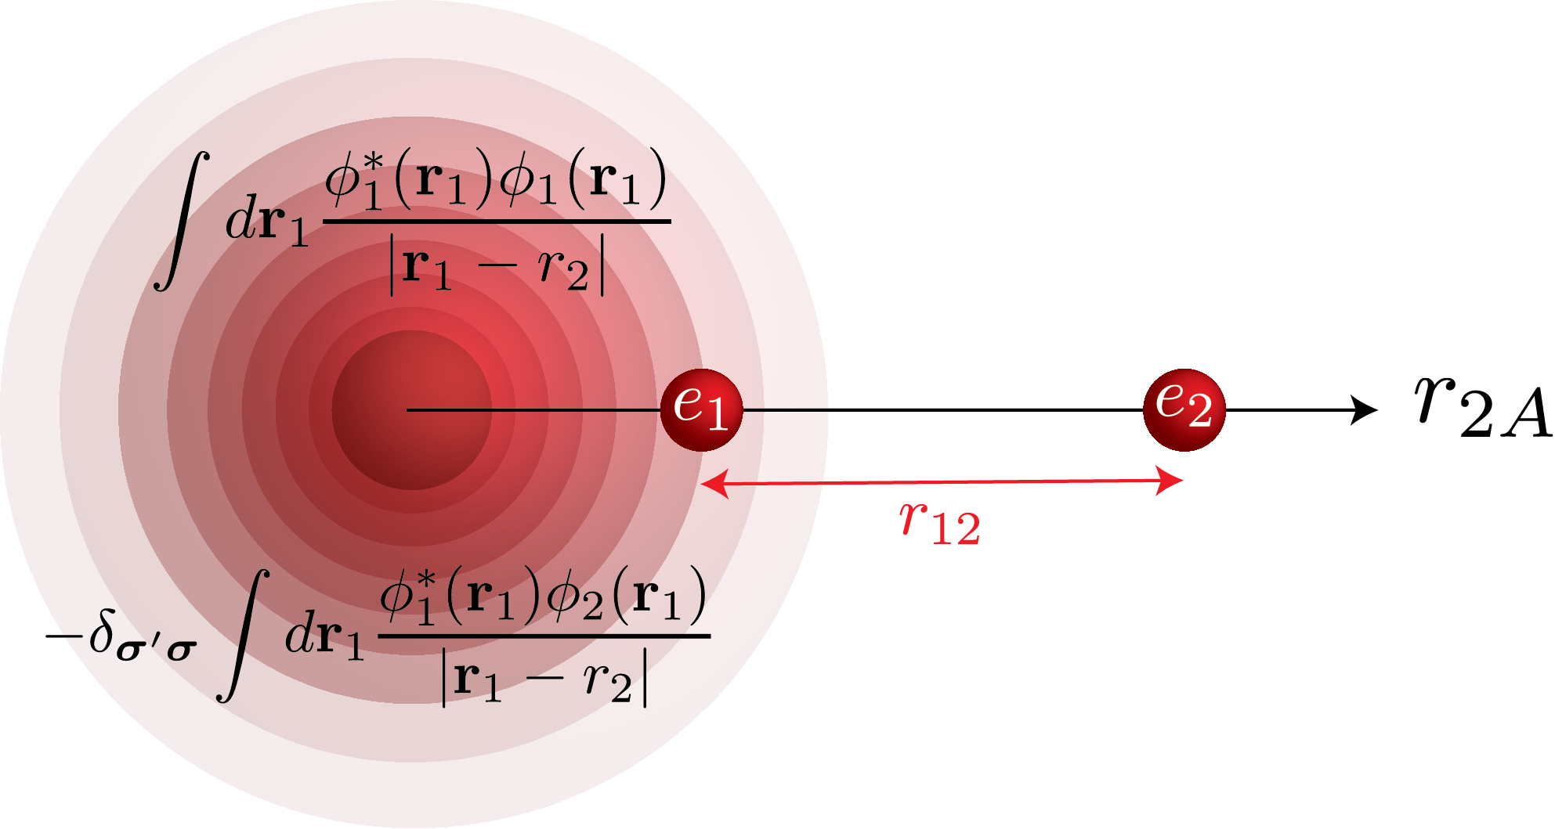
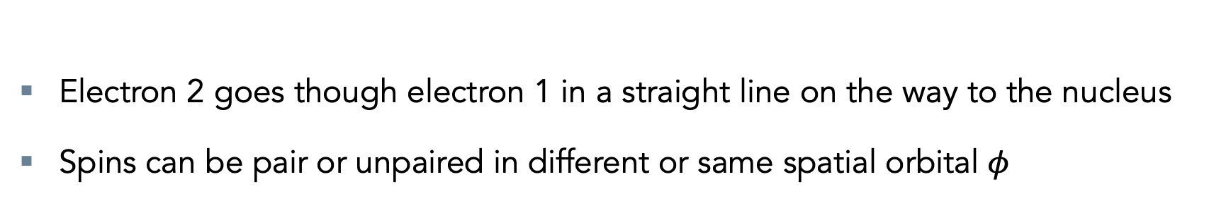
Thought experiment H⁻
Electron 2 goes though electron 1 in a straight line on the way to the nucleus
Spins can be pair or unpaired in different or same spatial orbital $φ$

Slide 30
Thought experiment H⁻
Treat as potential function of r1 for a fixed r2
Compare to instantaneous point charge at r1 and r2
Very different!

Slide 31
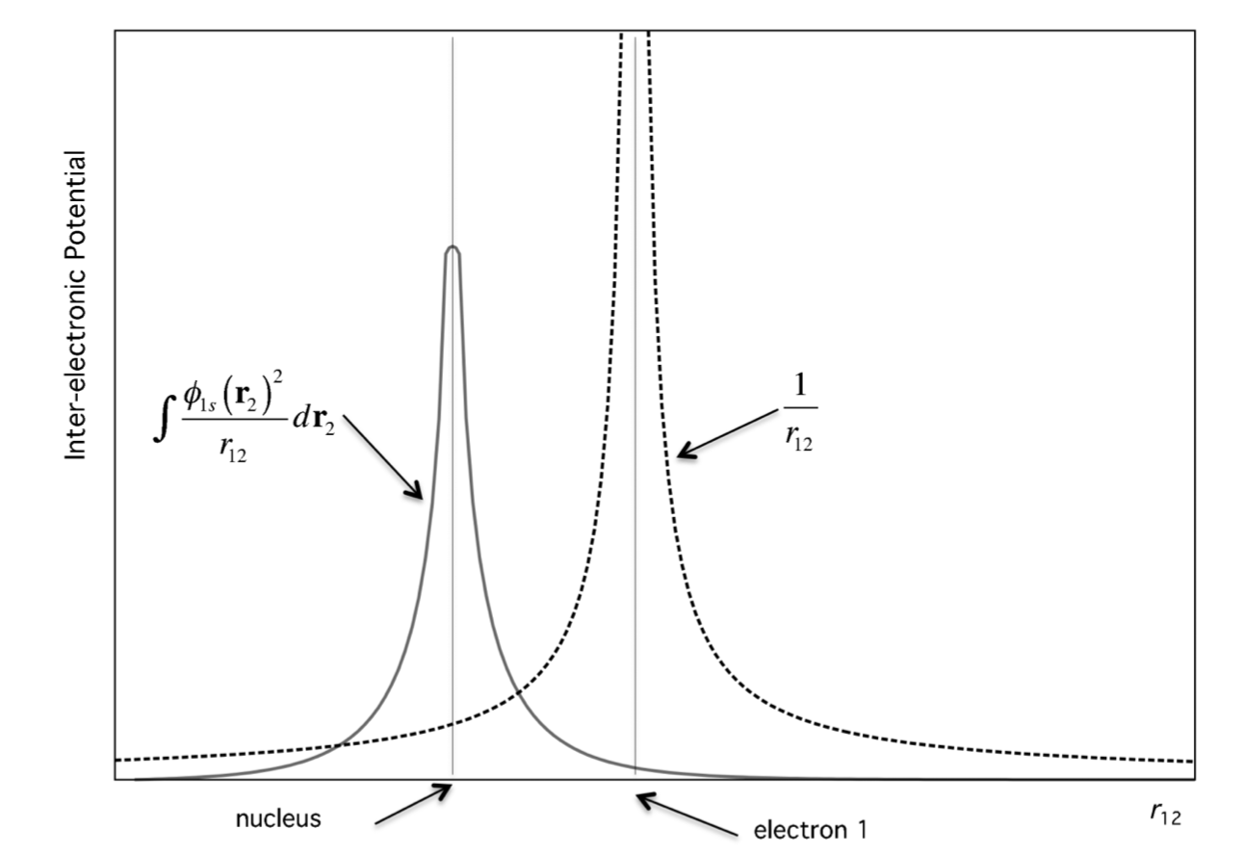
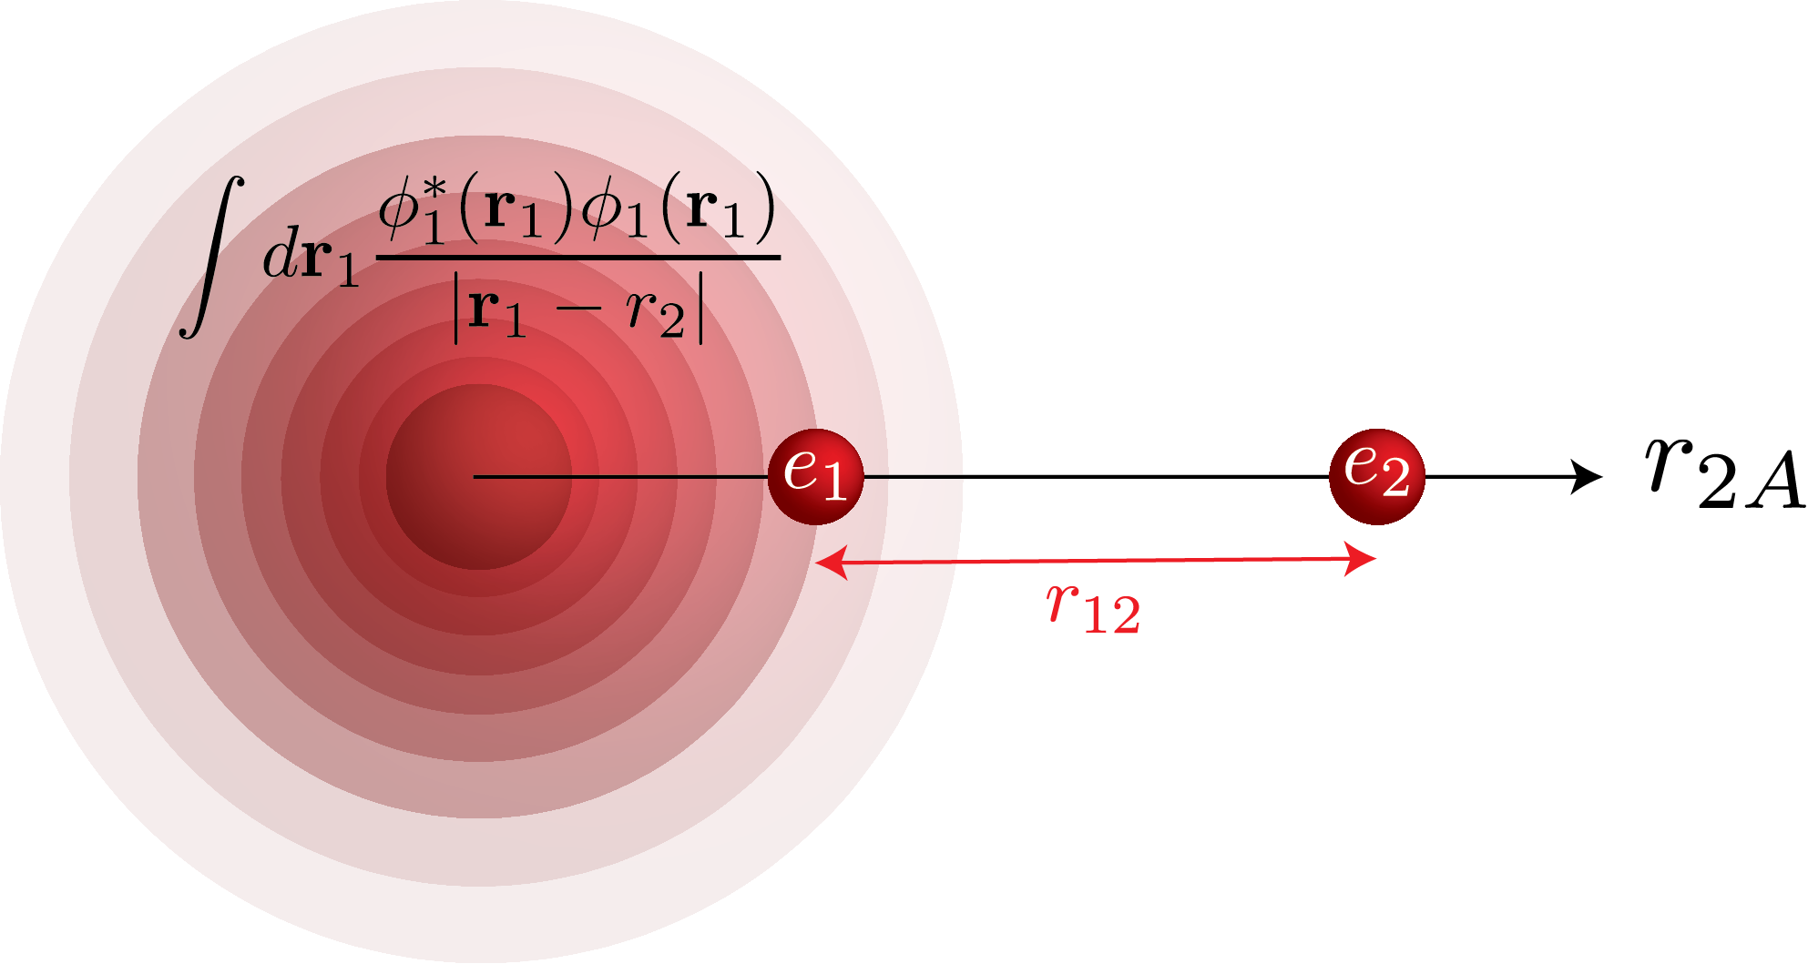
Thought experiment H⁻
Anti parallel spins
For electron 2 When electron 1 is fixed at r1
Exchange term goes to zero
Only Coulomb MF term present
Only knowns about mean field
In MF case e2 can in theory have non zero probability of being in the same place as e1 because of non infinity potential
Unphysical – electrons uncorrelated

Slide 32
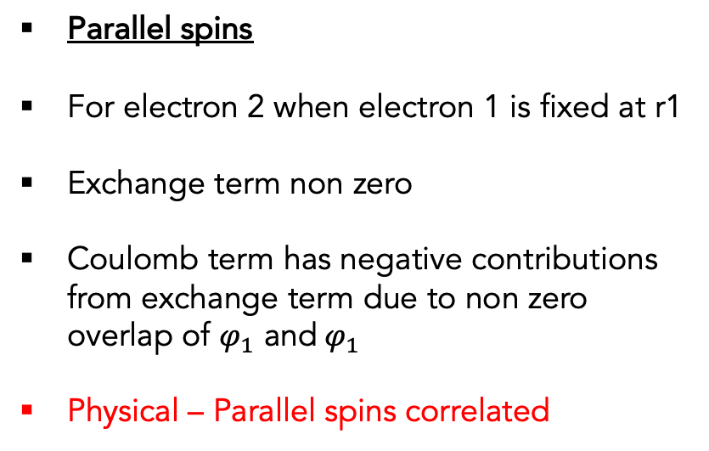
Thought experiment H⁻
Parallel spins
For electron 2 when electron 1 is fixed at r1
Exchange term non zero
Coulomb term has negative contributions from exchange term due to non zero overlap of $φ_{1}$ and${ φ}_{1}$
Physical – Parallel spins correlated

Slide 33
The FOCK Operator
Generalising this to K electrons making the mean field approximation

Slide 34
The FOCK OPerator
Expectation values
One electron operators

Slide 35
The FOCK Operator
Because:
Separable 1 electron operator which respects antisymmetry
Quite remarkable when you think antisymmetry requires two particles
1e Kinetic + ( Nuclear – Electronic repulsion)
Coulomb term has a classical analogue of averaged instantons point charge repulsions
Exchange term only exists due to the antisymmetry and is non classical

Slide 36
The FOCK Operator
Due to separability (exchange where electron i is in spin orbital j):
Still works as separability is due electron variables, not where the electron variable are:
1e Kinetic + ( Nuclear – Electronic repulsion)
Coulomb term has a classical analogue of averaged instantons point charge repulsions
Exchange term only exists due to the antisymmetry and is non classical

Slide 37
The FOCK Pseudo eigenvalue Problem
Non linear feedback loop
Must be solved iteratively until self consistency
1e Kinetic + ( Nuclear – Electronic repulsion)
Coulomb term has a classical analogue of averaged instantons point charge repulsions
Exchange term only exists due to the antisymmetry and is non classical

Slide 38
Introduce a Basis
So far we have been working with the functional form because some integro-differential equations can be solved with an analytical closed form solution
For multi nuclear centres with non electron nuclear spherical potential there is no analytical closed form solution
We must now introduce a finite basis!
Recall the generalised secular equation
Gives optimal basis set expansion parameters for a given non orthogonal basis spanning the Fock operator

Slide 39
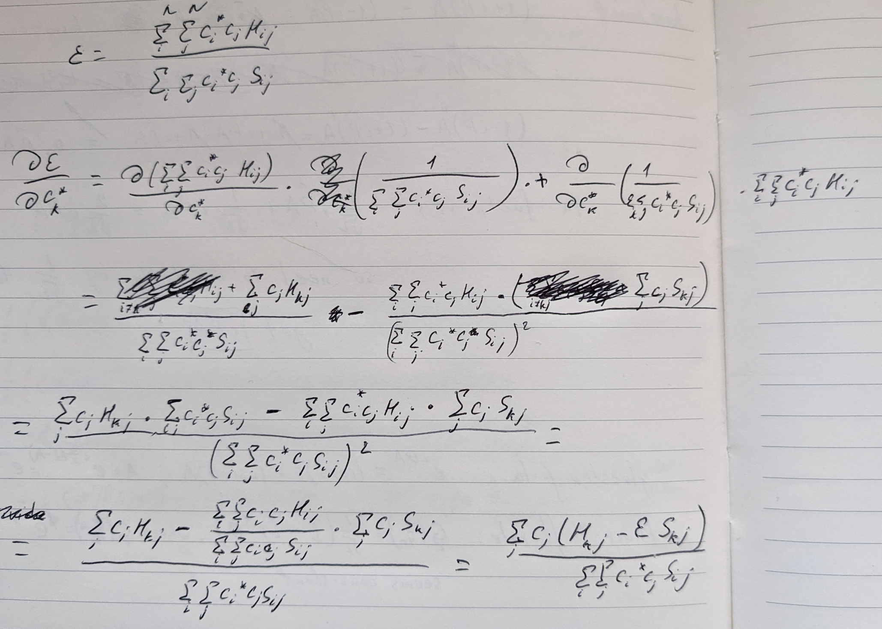
Yesterdays Problem Solution
Thanks Iakov!

Slide 40
What is a basis Set?
Car example:
More balls
Better shaped balls (higher dimensions)
Better fit to the exact wavefunction (black outline)

Slide 41
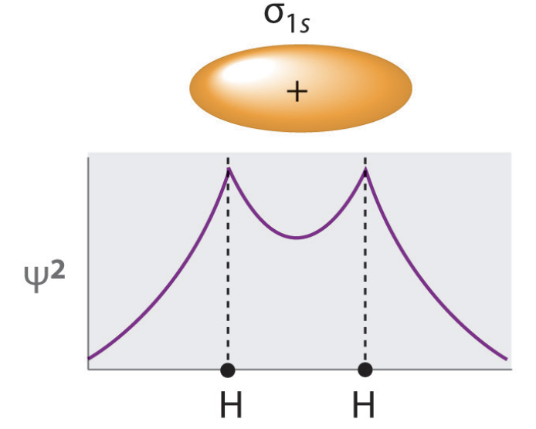
What is a basis Set?
WF example
Try to find some linear combination of functions that best fits the exact wavefunction
Try to fit linear
Combination of
approx. functions
to exact function

Slide 42
What is a basis Set?
WF example
Try to find some some linear combination of functions that best fits the exact wavefunction
Diagonalising the Fock Matrix does this for you because the secular equation finds the optimal eigenstates due to the variational principle!

Slide 43
What is a basis Set?
Not sure where this should be include
Slater Orbitals - STOs
Gaussian Orbitals - GTOs
Slater Orbitals more pointy like real cups

Slide 44
Guassian Basis Functions
Integral properties better
Product of two guassians is a Guassian

Slide 45
Exercises
Need to download pyscf!
pip install pyscf
If you have an arm mac come and find me.

